Slide 1
Chapter 9
Application: International Trade
Professor Galvez-Soriano lecture notes. Based on N. Gregory Mankiw, Principles of Microeconomics, 9th Edition.

Slide 2
The Determinants of Trade
The equilibrium without trade
Only domestic buyers and sellers
Equilibrium price and quantity
Determined on the domestic market
Total benefits
Consumer surplus
Producer surplus
Professor Galvez-Soriano lecture notes. Based on N. Gregory Mankiw, Principles of Microeconomics, 9th Edition.

Slide 3
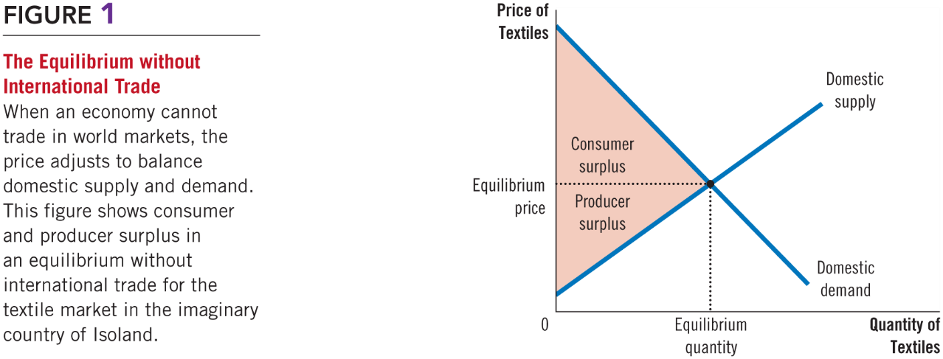
Figure 1 Equilibrium without International Trade
Professor Galvez-Soriano lecture notes. Based on N. Gregory Mankiw, Principles of Microeconomics, 9th Edition.

Slide 4
The Determinants of Trade
Allow for international trade?
Price and quantity sold in the domestic market?
Who will gain from free trade; who will lose, and will the gains exceed the losses?
Should a tariff be part of the new trade policy?
Professor Galvez-Soriano lecture notes. Based on N. Gregory Mankiw, Principles of Microeconomics, 9th Edition.
Notes:
We are going to answer all these questions today.

Slide 5
The Determinants of Trade
World price
Price of a good that prevails in the world market for that good
Professor Galvez-Soriano lecture notes. Based on N. Gregory Mankiw, Principles of Microeconomics, 9th Edition.

Slide 6
The Determinants of Trade
Compare domestic price with world price (in terms of opportunity cost: dollars/[units of good])
If domestic price < world price
Export the good
The country has comparative advantage
If domestic price > world price
Import the good
The world has comparative advantage
Professor Galvez-Soriano lecture notes. Based on N. Gregory Mankiw, Principles of Microeconomics, 9th Edition.

Slide 7
Winners and Losers from
Exporting country
Domestic equilibrium price before trade is below the world price
Once trade is allowed
Domestic price rises to equal the world price
Domestic quantity supplied is greater than domestic quantity demanded
The difference: exports
Professor Galvez-Soriano lecture notes. Based on N. Gregory Mankiw, Principles of Microeconomics, 9th Edition.

Slide 8
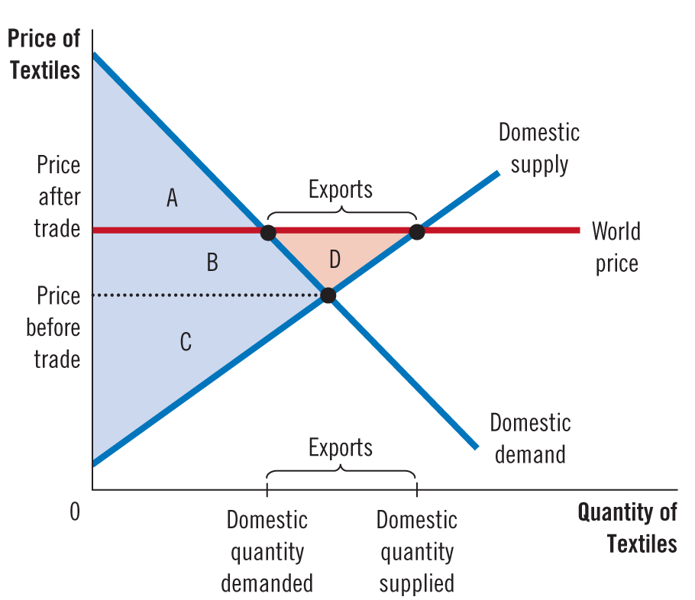
Figure 2 International Trade in an Exporting Country
Professor Galvez-Soriano lecture notes. Based on N. Gregory Mankiw, Principles of Microeconomics, 9th Edition.
Notes:
Exporting country
Before international trade
Consumer surplus
Producer surplus
With international trade
Smaller consumer surplus
Higher producer surplus
Higher total surplus

Slide 9
Winners and Losers from Trade
Exporting country, with international trade
Domestic producers of the good are better off
Domestic consumers are worse off
Trade raises the economic well-being of a nation
Gains of the winners exceed the losses of the losers
Professor Galvez-Soriano lecture notes. Based on N. Gregory Mankiw, Principles of Microeconomics, 9th Edition.

Slide 10
Winners and Losers from Trade
Importing country
Domestic equilibrium price before trade is above world price
Once trade is allowed
Domestic price drops to equal the world price
Domestic quantity supplied is less than domestic quantity demanded
The difference: imports
Professor Galvez-Soriano lecture notes. Based on N. Gregory Mankiw, Principles of Microeconomics, 9th Edition.

Slide 11
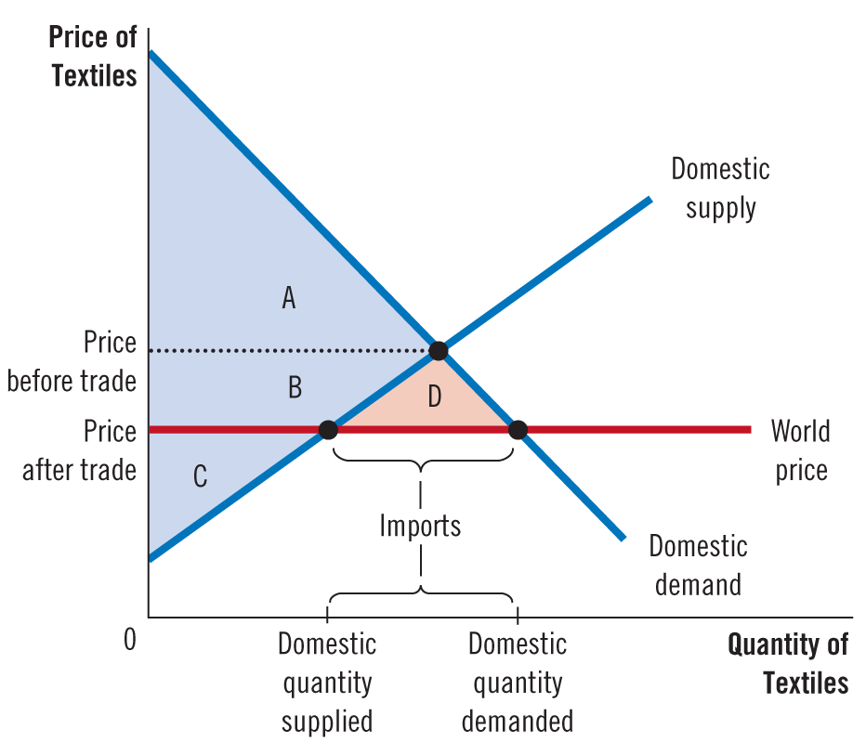
Figure 3 International Trade in an Importing Country
Professor Galvez-Soriano lecture notes. Based on N. Gregory Mankiw, Principles of Microeconomics, 9th Edition.
Notes:
Importing country
Before international trade
Consumer surplus
Producer surplus
With international trade
Higher consumer surplus
Smaller producer surplus
Higher total surplus

Slide 12
Winners and Losers from Trade
Importing country, with international trade
Domestic producers of the good are worse off
Domestic consumers are better off
Trade raises the economic well-being of a nation
Gains of the winners exceed the losses of the losers
Professor Galvez-Soriano lecture notes. Based on N. Gregory Mankiw, Principles of Microeconomics, 9th Edition.

Slide 13
Winners and Losers from Trade
Tariff
Tax on goods produced abroad and sold domestically
Free trade
Domestic price = World price
Tariff on imports
Raises domestic price above world price
By the amount of the tariff
Professor Galvez-Soriano lecture notes. Based on N. Gregory Mankiw, Principles of Microeconomics, 9th Edition.

Slide 14
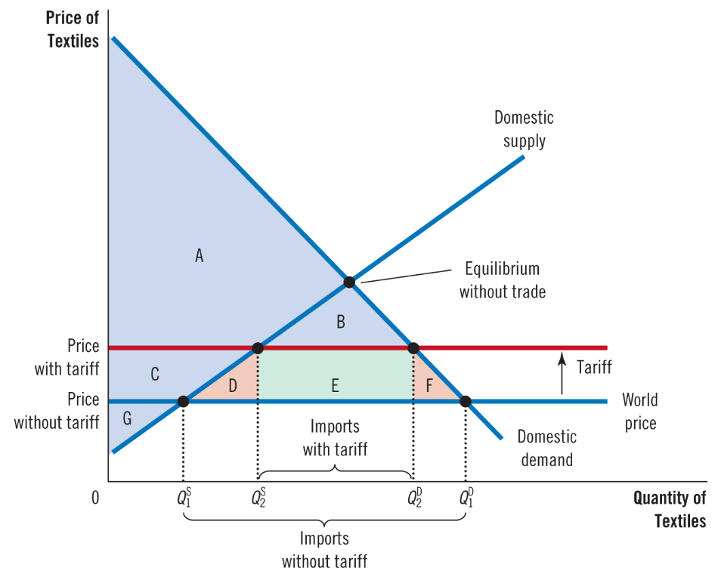
Figure 4 The Effects of a Tariff
Professor Galvez-Soriano lecture notes. Based on N. Gregory Mankiw, Principles of Microeconomics, 9th Edition.
Notes:
Government will collect E.
The effects of a tariff
Price rises by the amount of the tariff
Domestic quantity demanded decreases
Domestic quantity supplied increases
Reduces the quantity of imports
Moves the domestic market closer to its equilibrium without trade
Domestic sellers are better off
Domestic buyers are worse off

Slide 15
Winners and Losers from Trade
Other benefits of international trade
Increased variety of goods
Lower costs through economies of scale
Increased competition
Enhanced flow of ideas
Transfer of technological advances around the world
Professor Galvez-Soriano lecture notes. Based on N. Gregory Mankiw, Principles of Microeconomics, 9th Edition.

Slide 16
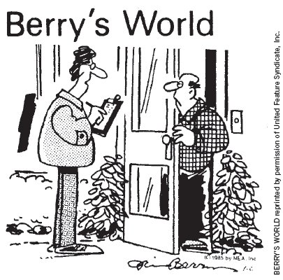
Arguments for Restricting
The domestic producers
Oppose free trade
Believe that the government should protect the domestic industry from foreign competition
“You like protectionism as a ‘working man.’ How about as a consumer?”
Professor Galvez-Soriano lecture notes. Based on N. Gregory Mankiw, Principles of Microeconomics, 9th Edition.

Slide 17
Arguments for Restricting
The jobs argument
“Trade with other countries destroys domestic jobs”
The national-security argument
“The industry is vital for national security”
Professor Galvez-Soriano lecture notes. Based on N. Gregory Mankiw, Principles of Microeconomics, 9th Edition.

Slide 18
Arguments for Restricting Trade
The infant-industry argument
“New industries need temporary trade restriction to help them get started”
The “temporary” policy is hard to remove
Protection is not necessary for an infant industry to grow
Professor Galvez-Soriano lecture notes. Based on N. Gregory Mankiw, Principles of Microeconomics, 9th Edition.

Slide 19
Arguments for Restricting Trade
The unfair-competition argument
“Free trade is desirable only if all countries play by the same rules”
Professor Galvez-Soriano lecture notes. Based on N. Gregory Mankiw, Principles of Microeconomics, 9th Edition.

